Slide 1


www.girlogistics.in
GIR is a multi-modal logistics company into this business since 1965. The company is having great experience and client base, having its presence across India and globe.
GIR provides you unparalleled solutions to expand your reach to every corner. We combine our deep understanding of the customer’s requirement with our strategic approach, providing a one-stop solution to get your logistics supply chain needs. This has been possible by virtue of sincere hard work put in by our team of dedicated individuals & modern infrastructure.

Slide 2
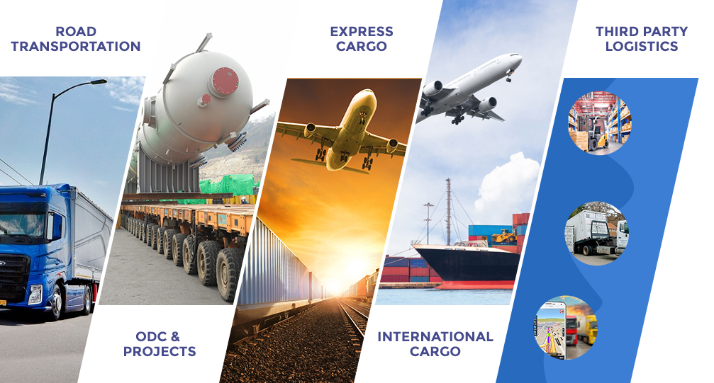
ROAD TRANSPORTAION
.
INTERNATIONAL CARGO
THIRD PARTY LOGISTICS
ODC & PROJECTS
EXPRESS CARGO
OUR
SERVICES

Slide 3

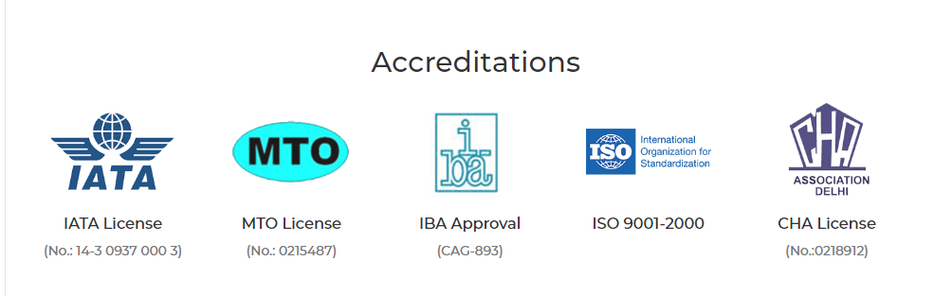
Experience GIR Logistics
GIR introduces itself, as a single solution provider for
all the procurement and distribution needs of the industry.
We at GIR believe that logistics plays a very crucial role in
any industry. It has direct bearing on the cost and efficiency
of any industrial operation. We at GIR strive to give efficient
services at most competitive prices.
Worldwide Locations
Customer Support
Fast & Affordable
Quality & Commitment
Latest Vehicle & Fleet
100% Satisfied Customer

Slide 4




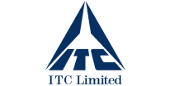


















Key Clients
Corporate Office
701-704, Roots Tower, District Centre
Laxmi Nagar, New Delhi, Delhi – 110092
Phone : 011-47670700, 22520634
Customer Care : 1800-111-447
Email : corporate@girlogistics.in

